Slide 1


Accident SEVERITY Prediction
Matteo Orsini 1795119
Fabrizio Rossi 1815023
Mina MAKAR 1804475

Slide 2
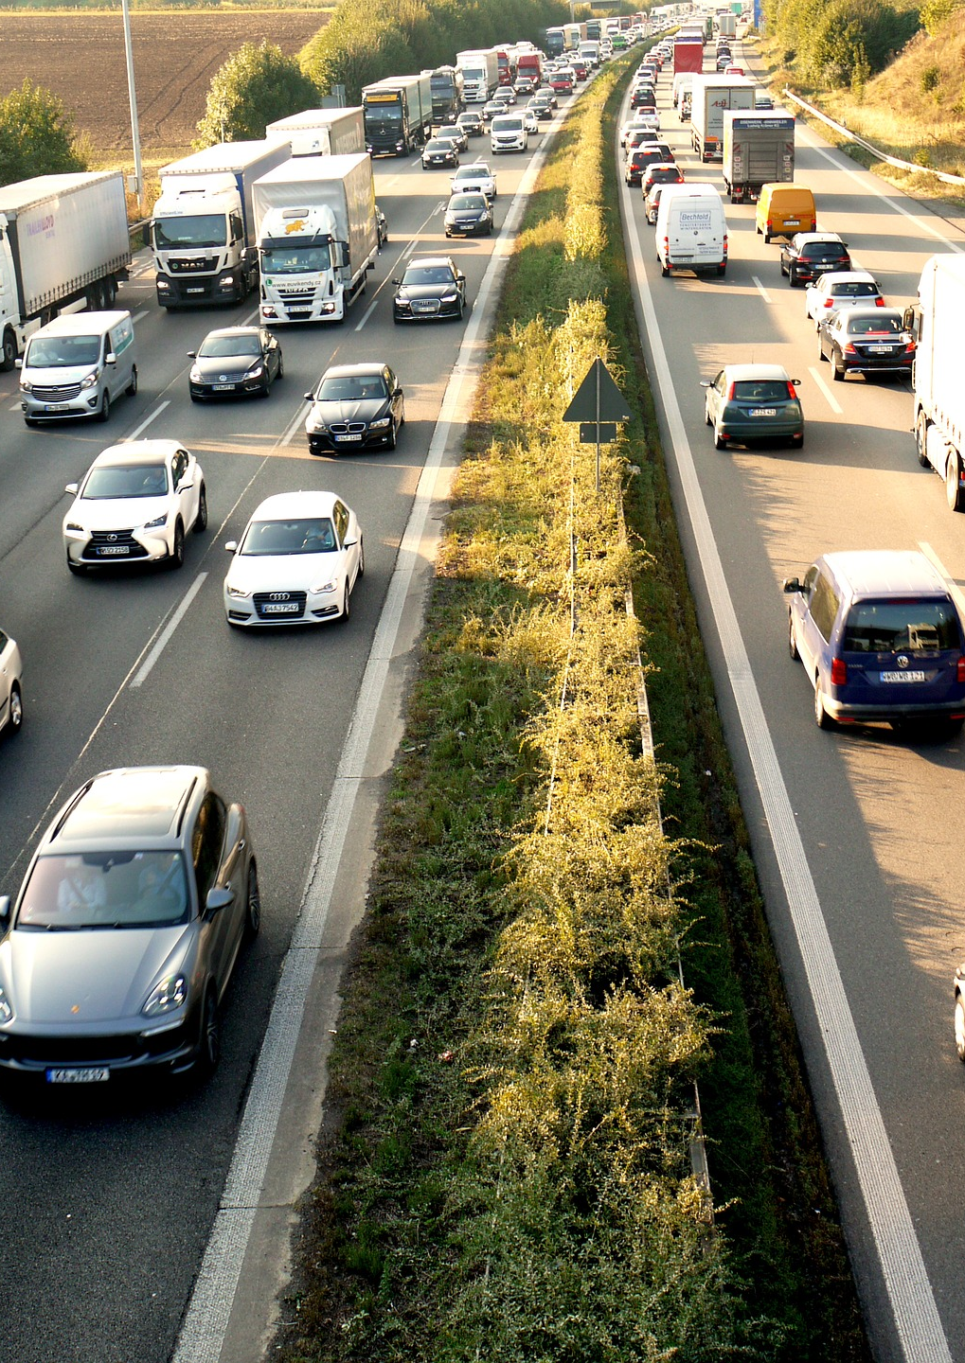
Task - Severity
Classify the impact of an accident on the traffic (severity)
The scale of the severity goes from 1 (low impact) to 4 (high impact)
We used the dataset «US Accidents» from Kaggle
Contains about 3.5 million accidents collected in the US

Slide 3
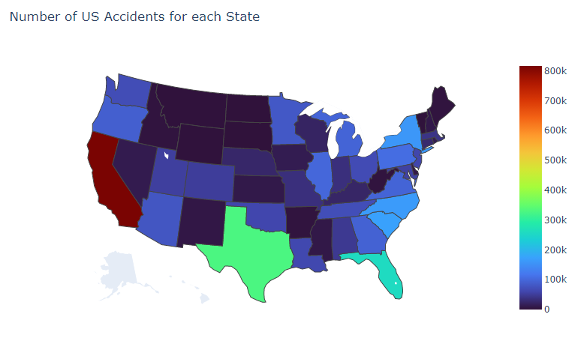
Exploratory Data Analysis

Slide 4
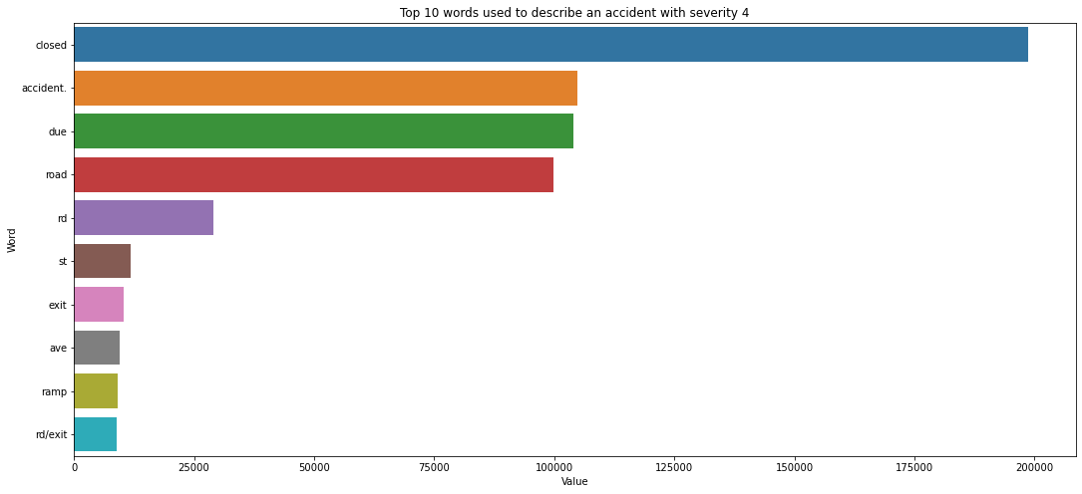
Exploratory Data Analysis

Slide 5
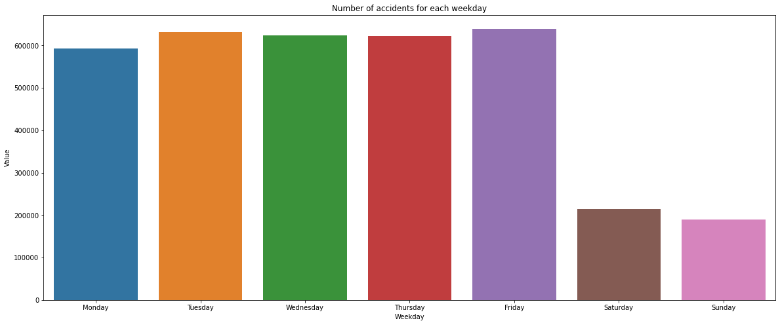
Exploratory Data Analysis

Slide 6
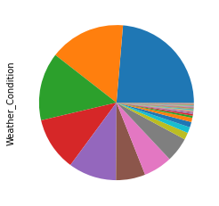
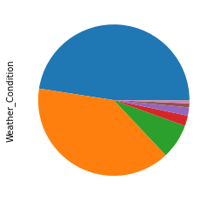
DATA PREPROCESSING
Reduced number of classes for Weather_Condition (128 → 11) and Wind_Direction (24 → 10)
Filled missing values with mean for numerical features
Removed records with missing values for categorical features
Scaled and encoded features using the one-hot encoding for the categorical features
City was encoded using the binary encoder due to the large number of unique values

Slide 7
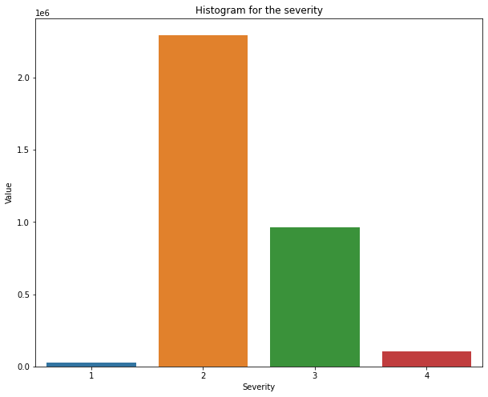
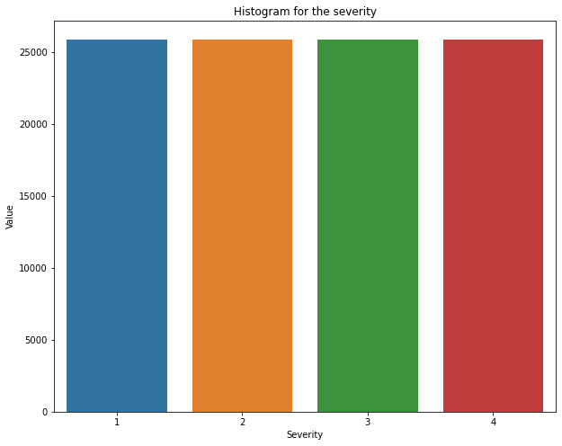
DATA PREPROCESSING
We handled the unbalanced dataset problem using the undersampling technique
We splitted the dataset in train set, validation set and test set
Dataset
64%
Train
16%
Validate
20%
Test

Slide 8
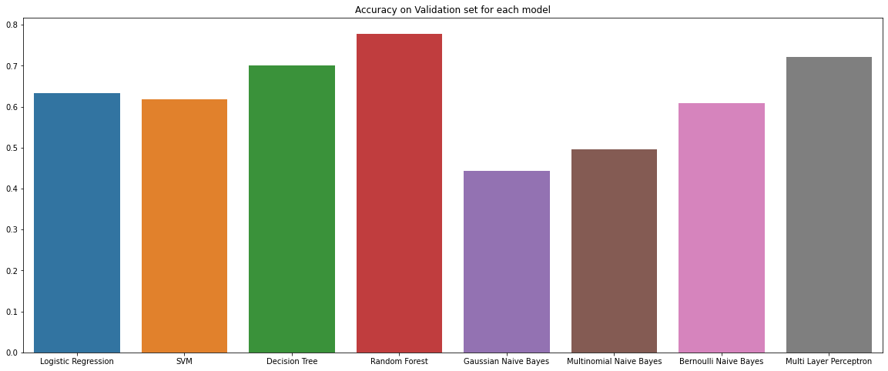
Results – ACCURACY

Slide 9
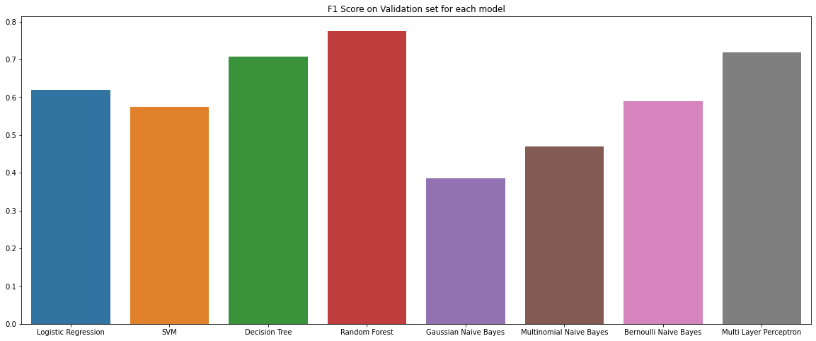
Results – F1 score

Slide 10
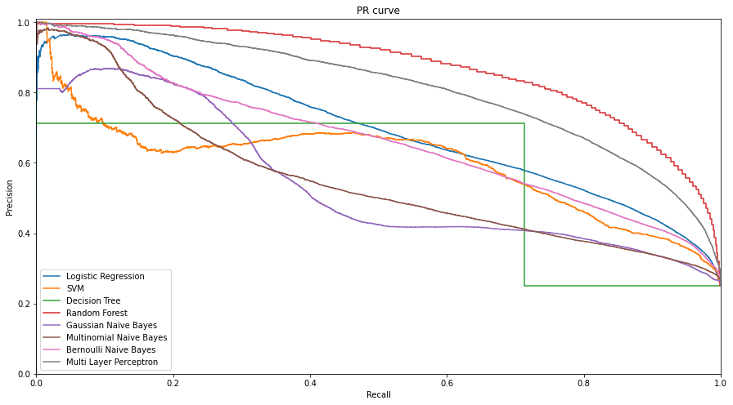
Results – PR Curve

Slide 11
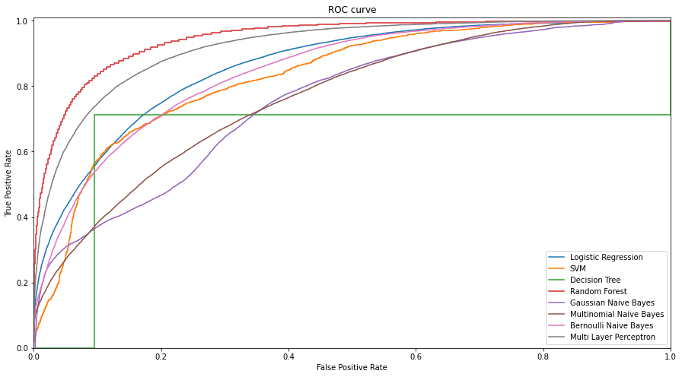
Results – ROC Curve

Slide 12
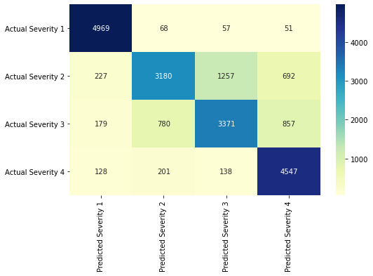
Results – Random forest test set
Class | Precision | Recall | F1-Score
1 | 0,90 | 0,97 | 0,93
2 | 0,75 | 0,59 | 0,66
3 | 0,70 | 0,65 | 0,67
4 | 0,74 | 0,91 | 0,81
Macro avg | 0,77 | 0,78 | 0,77

Slide 13
Related works
Medium Article (Link)
Kaggle Notebook (Link)

